Slide 1
THE CONVEYING WORKSHOP TEAM1 SPRINT 2
By: Aditya DAS
Jonathan MALLET
Jehad MELAD
Poulomi NANDY

Slide 2
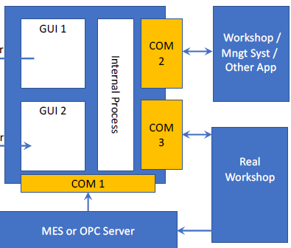
SPRINT 2(includes)
Internal Process
Conveying Belt
COM 1
COM 2

Slide 3
Conveying Belt
Collecting empty containers from storage facility.
Check if the pots are in proper state.
Calculate the number of pots transferred to filling.

Slide 4
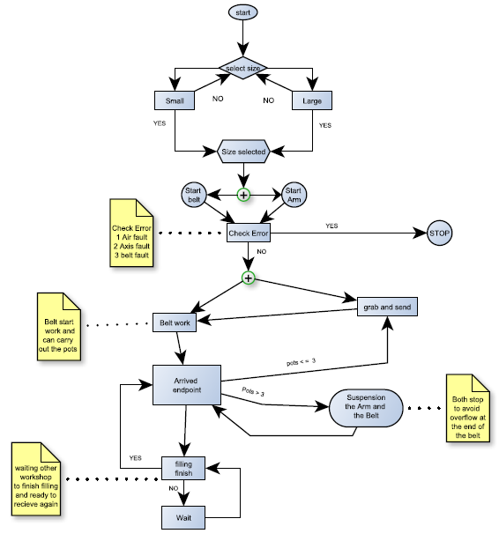
Conveying Belt workflow

Slide 5
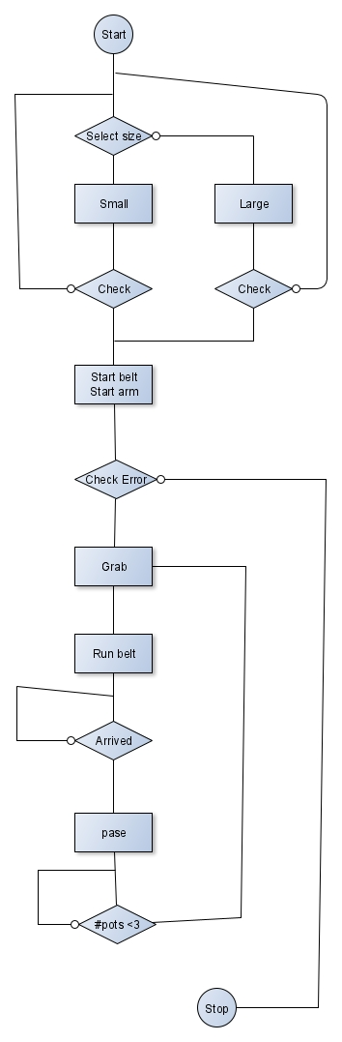
Conveying workflow

Slide 6
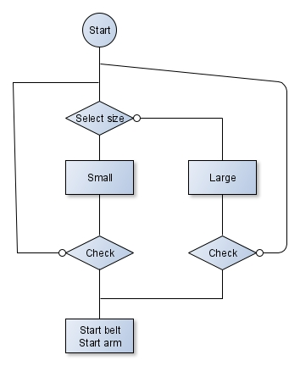
Conveying workflow

Slide 7
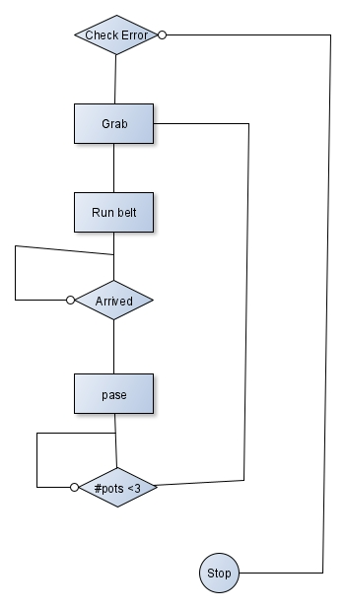
Conveying workflow

Slide 8
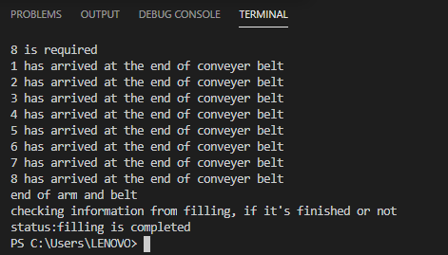
Terminal Output:
Code will be explained in demonstration.
Below is the output:

Slide 9
What is an OPC?
The OPC is basically an interface that allows a programme in Windows to communicate with industrial hardware.
Since it has a ‘Server-Client Approach’, wherein the server communicates with the real workshop, we have effectively designed the client.

Slide 10
import time
import win32com.client
# Instantiate the client object
client = win32com.client.Dispatch('................')
client.PullDataChangeNotificationQueueCapacity = 1000
print('Subscribing...')
client.SubscribeDataChange('http://opcua.demo-this.com:51211/UA/SampleServer',
'nsu=http://test.org/UA/Data/;i=10853', 1000)
print('Processing data change events for 1 minute...')
endTime = time.time() + 60
while time.time() < endTime:
eventArgs = client.PullDataChangeNotification(2*1000)
if eventArgs is not None:
# Handle the notification event
print(eventArgs)

Slide 11
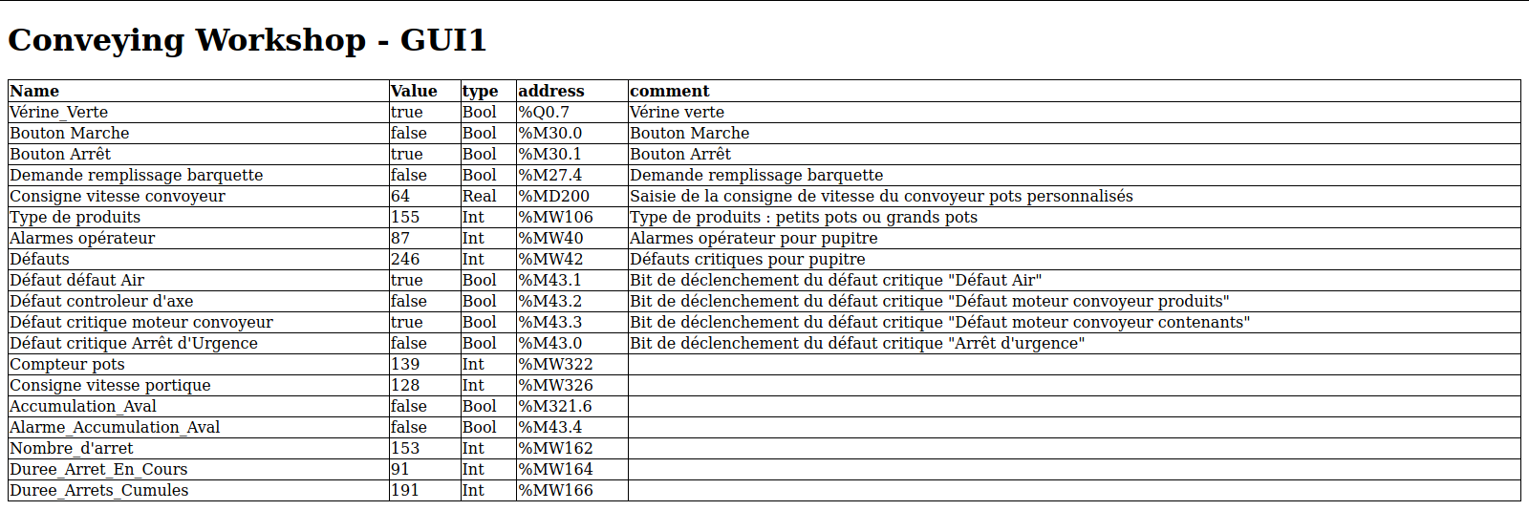
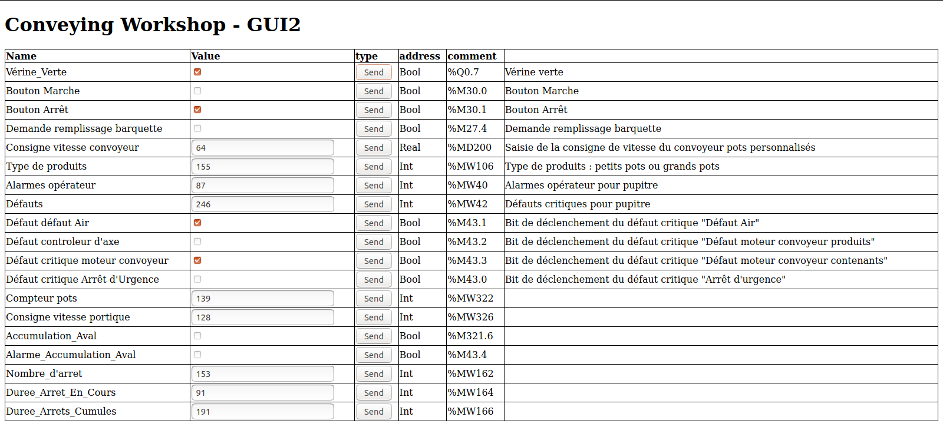

Slide 12
Remaining work

Slide 13
Thank you for your attention.

